Slide 1
BERLIN JEBA B S
ASSISTANT PROFESSOR ,AI&ML
JERUSALEM COLLEGE OF, ENGINEERING,PALLIKARANAI,
CHENNAI 600100.

Slide 2
UNIT I
DATA MODELS AND QUERYING

Slide 3
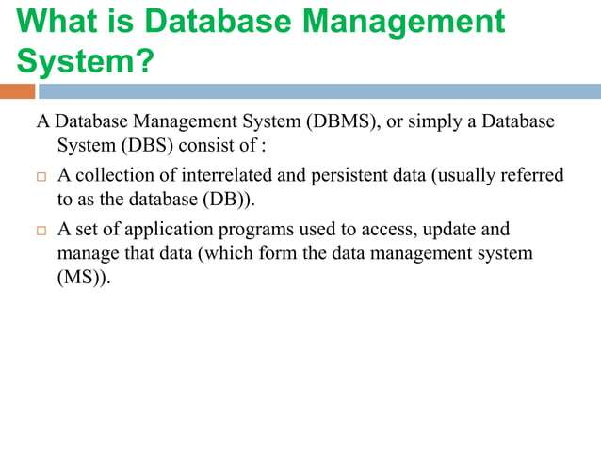

Slide 4
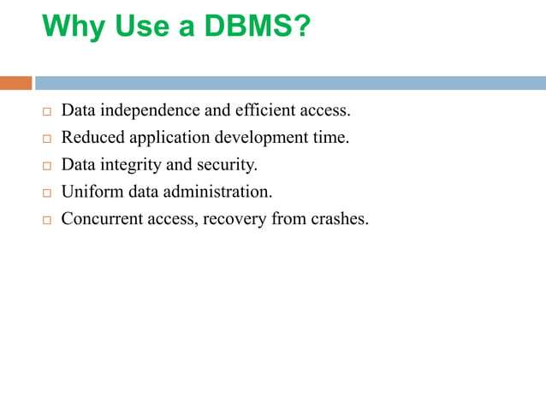

Slide 5
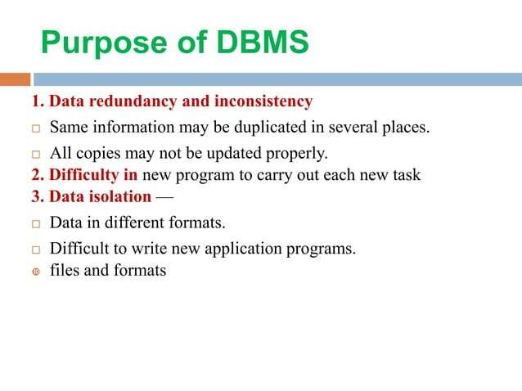

Slide 6
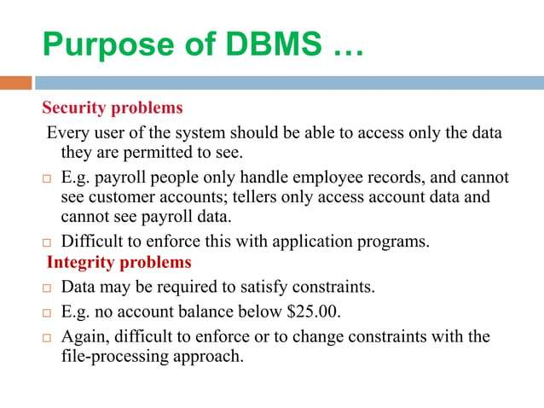

Slide 7
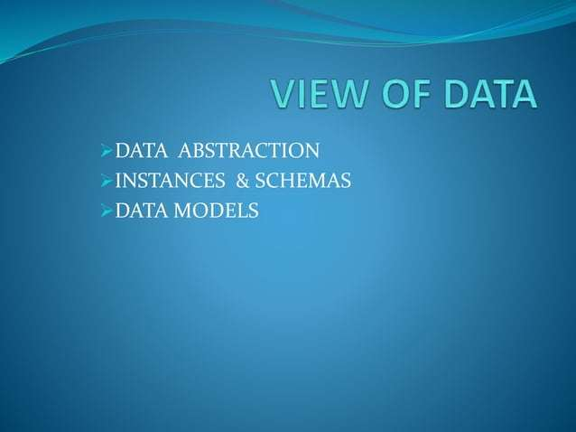

Slide 8


Slide 9
Data abstraction is the process of hiding unwanted and irrelevant details from the end user.
It keeps data safe by hiding how and where data is stored.
For example, while buying clothes, users see only color, size, and brand, not production details.

Slide 10
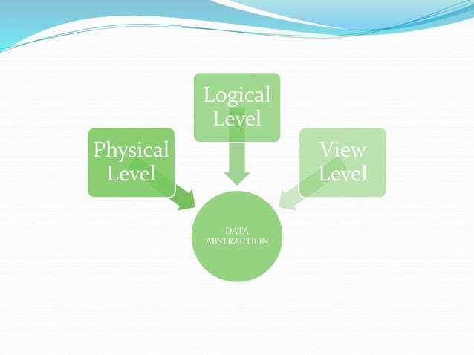

Slide 11
This is the core concept, using data abstraction to simplify interaction.
Physical Level: Lowest level; details how data is physically stored (files, indexes, storage paths).
Logical (Conceptual) Level: Describes the entire database structure (tables, fields, relationships) and what data exists, managed by DBAs.
View (External) Level: Highest level; provides customized subsets of the database for specific user groups, hiding irrelevant data.

Slide 12
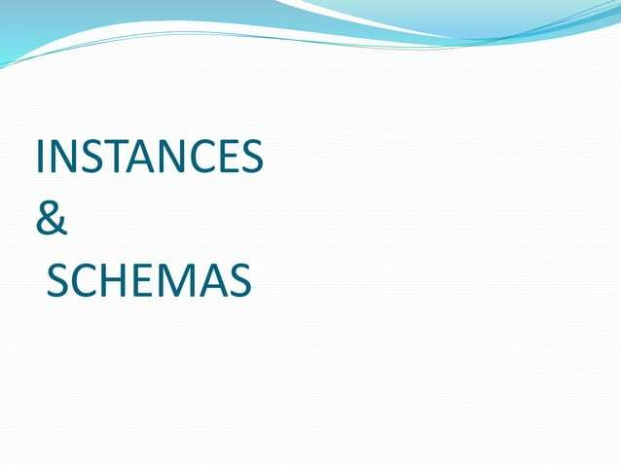

Slide 13
What is Schema?
A schema in DBMS refers to the overall design or blueprint of a database. It describes how the data will be organized, how the relationships between different entities will be maintained and how constraints will be applied.
Example: Let's say a table teacher in our database named school, the teacher table requires the name, dob and doj in their table so we design a structure as:
Teacher (
name VARCHAR,
dob DATE,
doj DATE)
What is Instance?
An instance of DBMS refers to real data present in a database at some particular point in time.
Example: Let say a table teacher in our database whose name is School, suppose the table has 50 records so the instance of the database has 50 records for now and tomorrow we are going to add another fifty records so tomorrow the instance has a total of 100 records. This is called an instance.

Slide 14
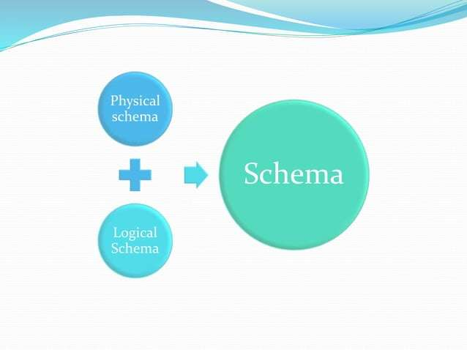

Slide 15
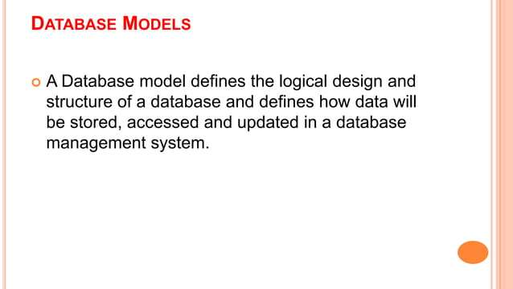

Slide 16
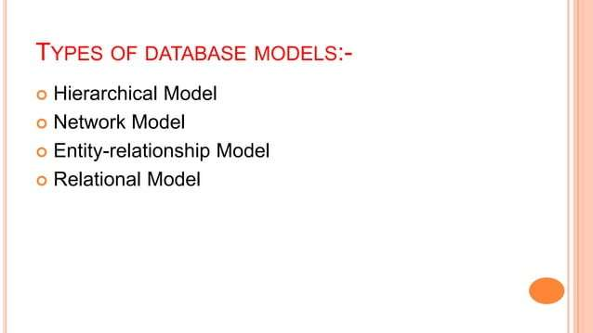

Slide 17
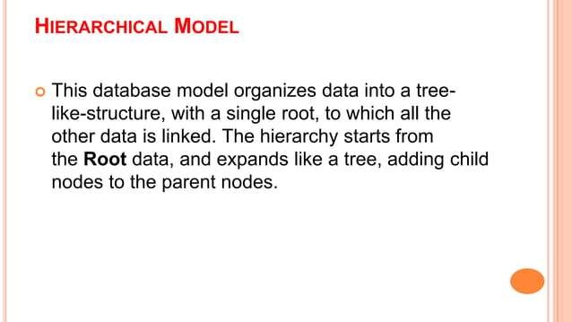

Slide 18
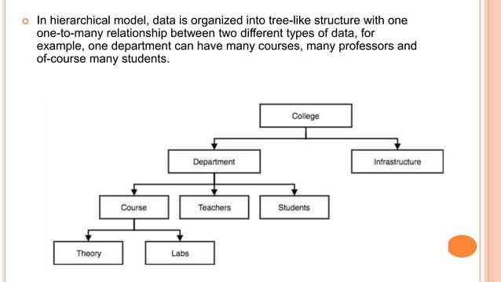

Slide 19
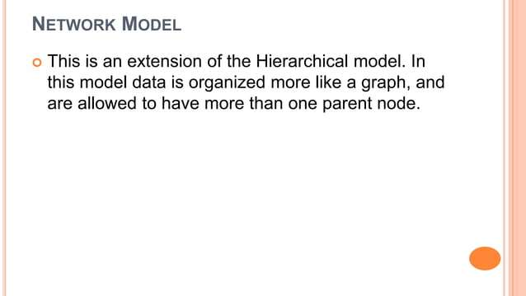

Slide 20
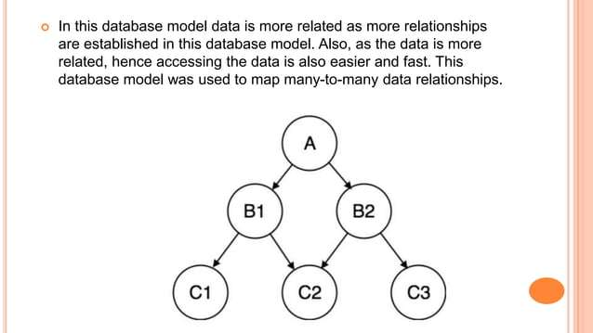

Slide 21
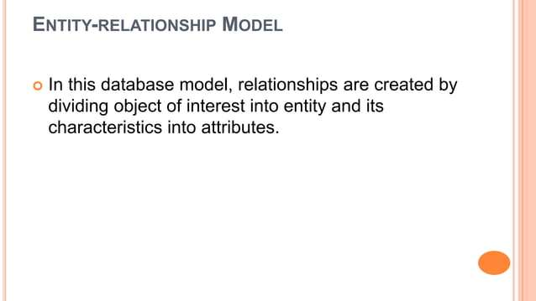

Slide 22
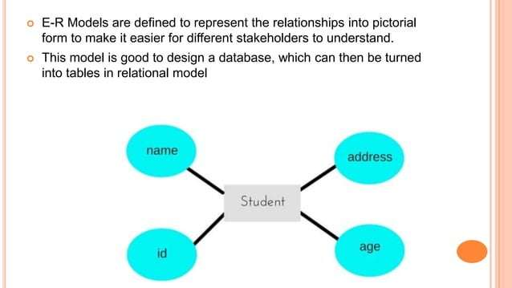

Slide 23
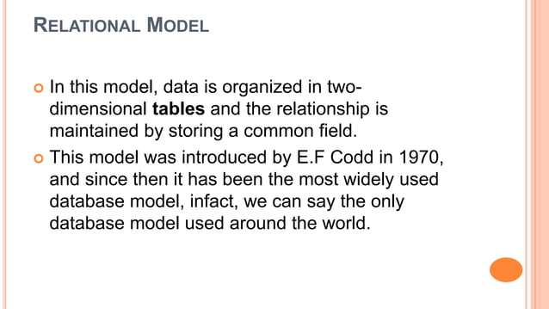

Slide 24
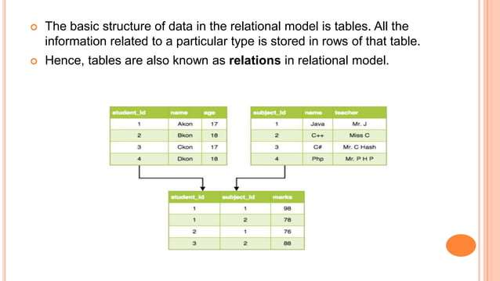

Slide 25
DBMS Architecture 1-level, 2-Level, 3-Level
DBMS architecture defines how users interact with the database to read, write, or update information. Types of DBMS Architecture
There are several types of DBMS Architecture that we use according to the usage requirements.
1-Tier Architecture
2-Tier Architecture
3-Tier Architecture

Slide 26
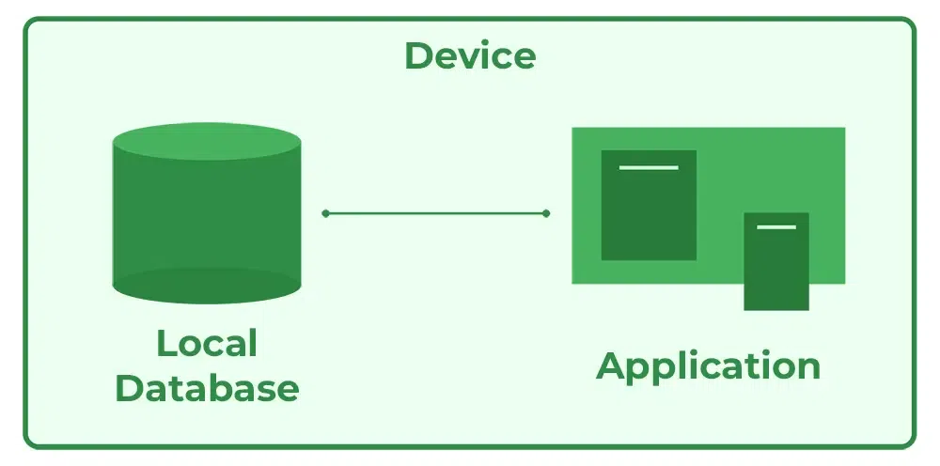
1-Tier Architecture
In 1-Tier Architecture, the user works directly with the database on the same system. This means the client, server and database are all in one application. The user can open the application, interact with the data and perform tasks without needing a separate server or network connection.
A common example is Microsoft Excel. Everything from the user interface to the logic and data storage happens on the same device. The user enters data, performs calculations and saves files directly on their computer.

Slide 27
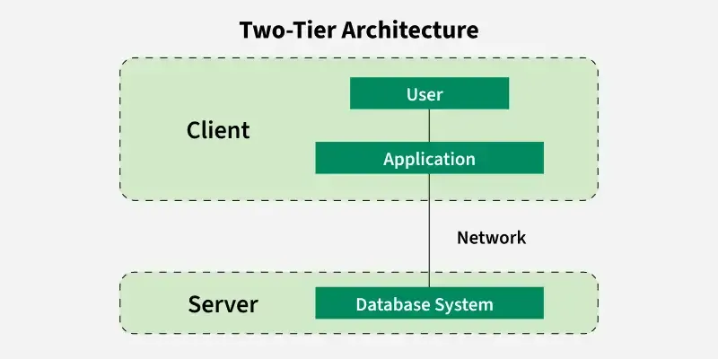
2-Tier Architecture
The 2-tier architecture is similar to a basic client-server model. The application at the client end directly communicates with the database on the server side. APIs like ODBC and JDBC are used for this interaction.
For Example: A Library Management System used in schools or small organizations is a classic example of two-tier architecture.

Slide 28
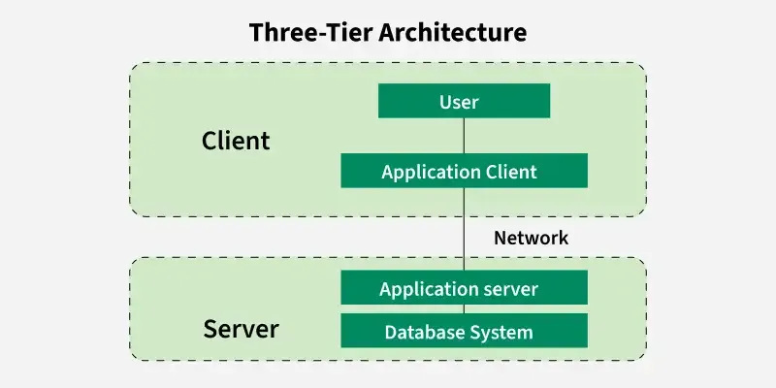
3-Tier Architecture
In 3-Tier Architecture, there is another layer between the client and the server. The client does not directly communicate with the server. Instead, it interacts with an application server which further communicates with the database system and then the query processing and transaction management takes place.
Example: E-commerce Store
User: You visit an online store, search for a product and add it to your cart.
Processing: The system checks if the product is in stock, calculates the total price and applies any discounts.
Database: The product details, your cart and order history are stored in the database for future reference.

Slide 29
Relational Model in DBMS
The Relational Model organizes data using tables (relations) consisting of rows and columns.
The relational model represents how data is stored and managed in Relational Databases where data is organized into tables, each known as a relation.
Each row of a table represents an entity or record and each column represents a particular attribute of that entity.
The relational model transforms conceptual designs from ER diagrams into implementable structures. These structures are used in relational database systems like Oracle SQL and MySQL.

Slide 30
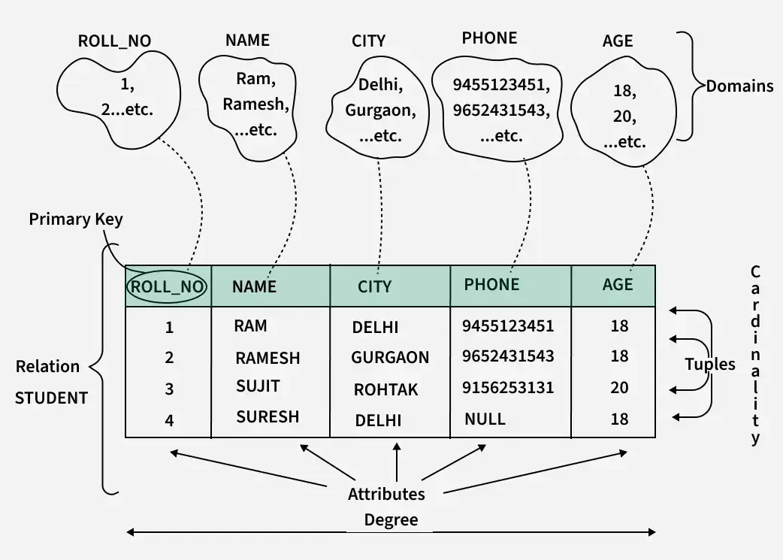

Slide 31
Key Terms in the Relational Model
Attribute: Attributes are the properties that define an entity. For example, ROLL_NO, NAME, ADDRESS etc.
Relation Schema: A relation schema defines the structure of the relation and represents the name of the relation with its attributes. For example, STUDENT (ROLL_NO, NAME, ADDRESS, PHONE and AGE) is the relation schema for STUDENT. If a schema has more than 1 relation it is called Relational Schema.
Tuple: A Tuple represents a row in a relation. Each tuple contains a set of attribute values that describe a particular entity. For example, (1, RAM, DELHI, 9455123451, 18) is a tuple in the STUDENT table.
Relation Instance: The set of tuples of a relation at a particular instance of time is called a relation instance. It can change whenever there is an insertion, deletion or update in the database.

Slide 32
Degree: The number of attributes in the relation is known as the degree of the relation. For example, The STUDENT relation has a degree of 5, as it has 5 attributes.
Cardinality: The number of tuples in a relation is known as cardinality. For example, The STUDENT relation defined above has cardinality 4.
NULL Values: The value which is not known or unavailable is called a NULL value. It is represented by NULL. For example, PHONE of STUDENT having ROLL_NO 4 is NULL.

Slide 33
Types of Keys in the Relational Model
Super Key: A Super Key is a set of attributes that can uniquely identify a tuple.
Candidate Key: A Candidate Key is a minimal set of super key.
Primary Key: A Primary Key uniquely identifies each tuple in a relation. It must contain unique values and cannot have NULL values.
Foreign Key: A Foreign Key is an attribute in one relation that refers to the primary key of another relation.
Composite Key: A Composite Key is formed by combining two or more attributes to uniquely identify a tuple.

Slide 34
Introduction of Relational Algebra in DBMS
Relational Algebra is a procedural query language used in Database Management Systems (DBMS).
It works on relations (tables) and uses a set of operations to retrieve and manipulate data.
STUDENT Table:
SID | Name | Dept | Age
1 | Ravi | CSE | 20
2 | Meena | ECE | 21
3 | Arjun | CSE | 22

Slide 35
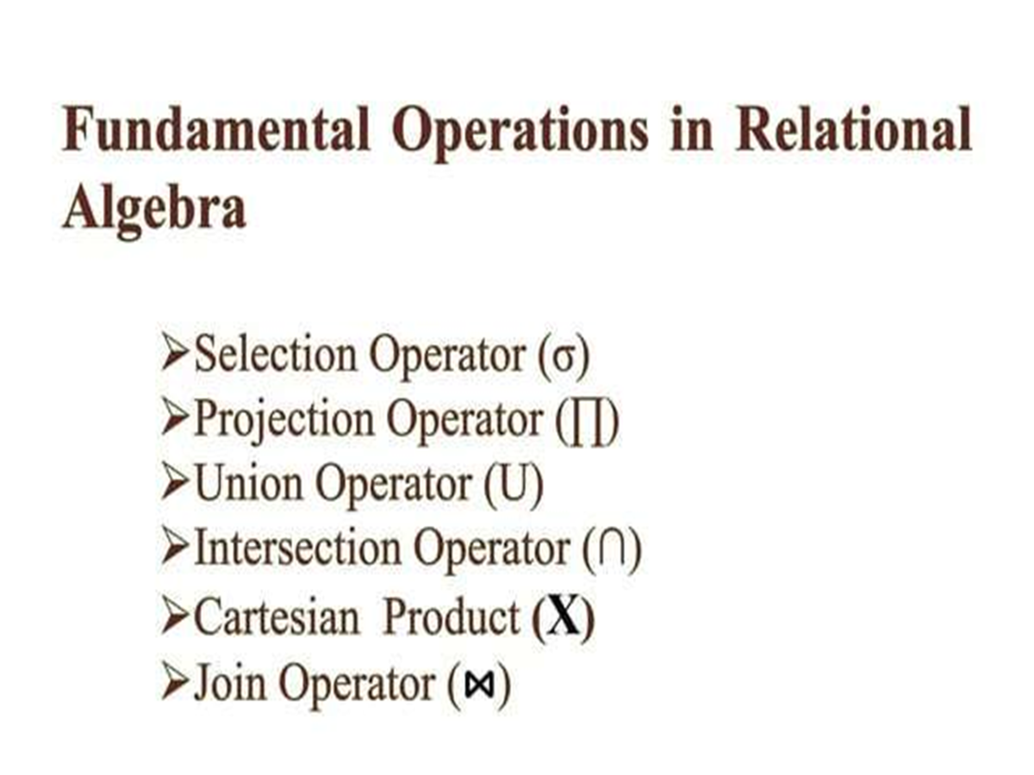

Slide 36
Selection (σ)
Purpose: Selects rows that satisfy a condition
Symbol: σ (sigma)
Example:
Get students from CSE department
σ Dept = 'CSE' (STUDENT)
SID | Name | Dept | Age
1 | Ravi | CSE | 20
3 | Arjun | CSE | 22

Slide 37
Projection (π)
Projection (π)
Purpose: Selects specific columns
Symbol: π (pi)
Example:
Get only student names and departments
π Name, Dept (STUDENT)
Name | Dept
Ravi | CSE
Meena | ECE
Arjun | CSE

Slide 38
Union (∪)
Purpose: Combines two relations (must have same attributes)
Let:
R = CSE Students
S = ECE Students
R ∪ S
Gives all students from both relations.

Slide 39
Table R – CSE Students
SID | Name | Dept
1 | Ravi | CSE
2 | Arjun | CSE
Table S – ECE Students
SID | Name | Dept
2 | Arjun | CSE
3 | Meena | ECE
Result
SID | Name | Dept
1 | Ravi | CSE
2 | Arjun | CSE
3 | Meena | ECE

Slide 40
Set Difference (−)
Purpose: Returns records in one table but not in another
Example:
Students in CSE but not in ECE:
R − S
Result
SID | Name | Dept
1 | Ravi | CSE

Slide 41
Cartesian Product (×)
Purpose: Combines every row of one table with every row of another.
STUDENT × COURSE
R.SID | R.Name | R.Dept | S.SID | S.Name | S.Dept
1 | Ravi | CSE | 2 | Arjun | CSE
1 | Ravi | CSE | 3 | Meena | ECE
2 | Arjun | CSE | 2 | Arjun | CSE
2 | Arjun | CSE | 3 | Meena | ECE

Slide 42
Rename (ρ)
Purpose: Renames a relation or attributes.
ρ S (STUDENT)
Meaning
  This renames the STUDENT table as S
Rename Attributes (Columns)
ρ S(SID, SName, Department, SAge) (STUDENT)
SID | SName | Department | SAge
1 | Ravi | CSE | 20
2 | Meena | ECE | 21

Slide 43
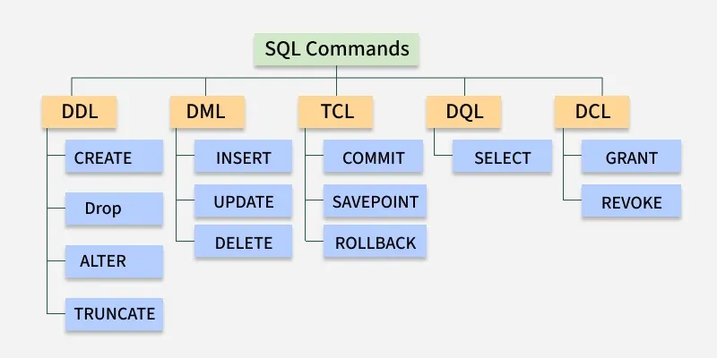
SQL Commands
SQL commands are used to perform operations include creating a table, adding data to tables, dropping the table, modifying the table and set permission for users.

Slide 44
DDL - Data Definition Language
command | Description | Syntax
CREATE | Create database or its objects (table, index, function, views, store procedure and triggers) | CREATE TABLE table_name (column1 data_type, column2 data_type, ...);
DROP | Delete objects from the database | DROP TABLE table_name;
ALTER | Alter the structure of the database | ALTER TABLE table_name ADD COLUMN column_name data_type;
TRUNCATE | Remove all records from a table, including all spaces allocated for the records are removed | TRUNCATE TABLE table_name;

Slide 45
DML - Data Manipulation Language
With DML, you can insert new records, update existing ones, delete unwanted data or retrieve information.
Command | Description | Syntax
INSERT | Insert data into a table | INSERT INTO table_name (column1, column2, ...) VALUES (value1, value2, ...);
UPDATE | Update existing data within a table | UPDATE table_name SET column1 = value1, column2 = value2 WHERE condition;
DELETE | Delete records from a database table | DELETE FROM table_name WHERE condition;

Slide 46
DQL - Data Query Language
DQL is used to fetch data from the database.
Command | Description | Syntax
SELECT | It is used to retrieve data from the database | SELECT column1, column2, ...FROM table_name WHERE condition;
SELECT * FROM table_name;

Slide 47
DCL - Data Control Language
DCL (Data Control Language) includes commands such as GRANT and REVOKE which mainly deal with the rights, permissions and other controls of the database system.
Command | Description | Syntax
GRANT | Assigns new privileges to a user account, allowing access to specific database objects, actions or functions. | GRANT privilege ON table_name TO user_name;
REVOKE | Removes previously granted privileges from a user account, taking away their access to certain database objects or actions. | REVOKE privilege ON table_name FROM user_name;

Slide 48
TCL - Transaction Control Language
Each transaction begins with a specific task and ends when all the tasks in the group are successfully completed. If any of the tasks fail, transaction fails.
Command | Description | Syntax
BEGIN TRANSACTION | Starts a new transaction | BEGIN TRANSACTION [transaction_name];
COMMIT | Saves all changes made during the transaction | COMMIT;
ROLLBACK | Undoes all changes made during the transaction | ROLLBACK;
SAVEPOINT | Creates a savepoint within the current transaction | SAVEPOINT savepoint_name;

